Slide 1
Picture Perfect: Revolutionizing Your Photo Experience with Smart Gallery
-Author
Khushil Ketankumar Modi
Rajvi Shah
Sarjak Patel
Vishnu Vardhan Reddy Yeruva
Advisor: Prof. Vijay Eranti

Slide 2
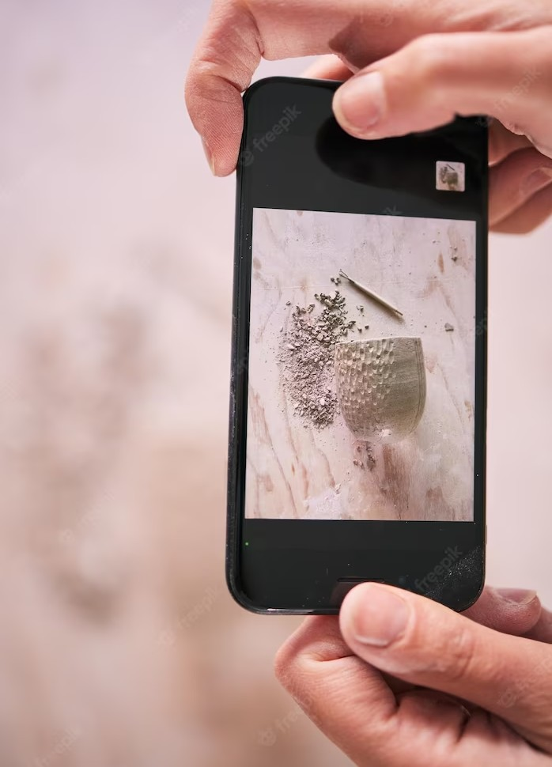
Introducing Smart Gallery
01.
Abstract
02.
Problem and Introduction
03.
Architecture & Tech
04.
Features
05.
Conclusion

Slide 3
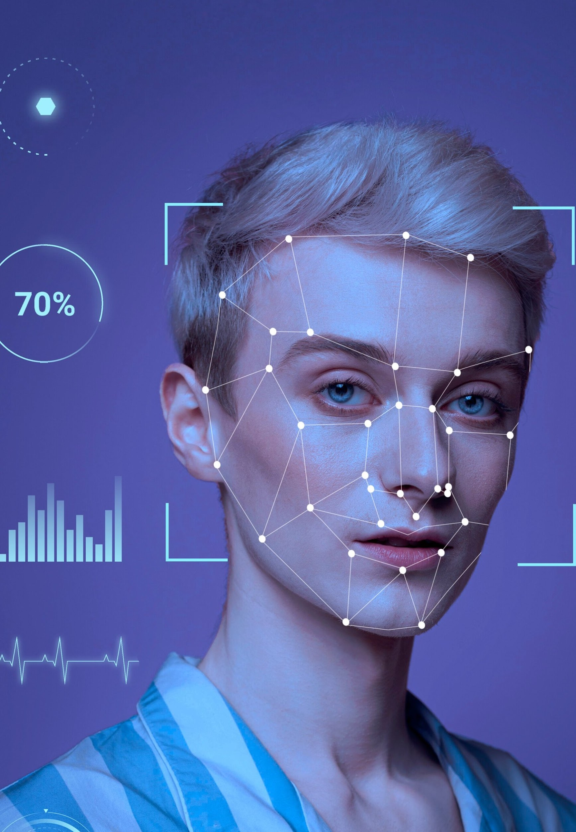
Abstract
The project “Smart Photo Gallery Application” is
designed and built simply but beautifully to make life
easier. Applications are generally designed traditionally as two types, one is giving what is required and the other
one is giving what is expected.
Out of these two, there is something that is practically missing what is useful.
Here the combination of a trail of new algorithms from the segment of what is expected and taking the
interface from what is required to make something useful, helpful and smart.

Slide 4
Problem Discussion & Introduction
Problem: Nowadays increasing popularity Introduction: Implementing recognition,
in the multimedia sector, people always
object detection, and OCR in photo albums
enables improved organization and text-based
image searching. OpenCV, face encodings, and VGG 19 aid in people classiﬁcation.
Advanced image editing tools automatically
enhance images based on person's emotion
want something that can create, manage
and organize automatically. Taking advantage of one such gap in the
technology area, ﬁlling it with cutting-
edge technologies by using
machine-learning algorithms and making it a future proof application using adaptive learning.
default presets and sentiment analysis.
Current state of the art AI methods to deliver amazing and more immersive experience.

Slide 5
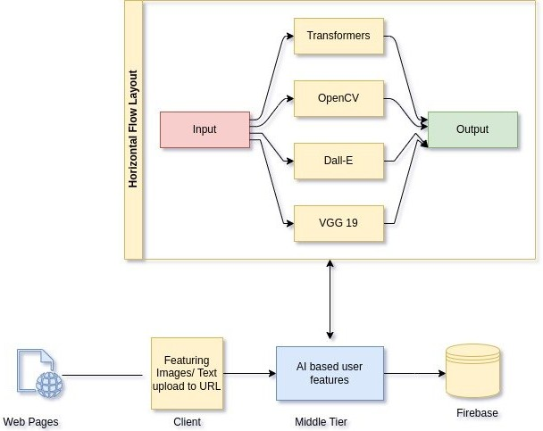
Architecture
The above diagram is the high-level architecture of the application. The client will login or register to the application. The user database will work on the access control of the user. After successful login, users can upload their photos into the application.
Application will consider the photos as an input for the middle-tier and process the required feature based on
their selection, the model will start iterating through photos and extracting the features. In this application we will be using some important state of art libraries for searching and detection. Whenever a client wants
to search photos, the application will get the data from the metadata database and show those images to the user. Users also can download those images using the application

Slide 6
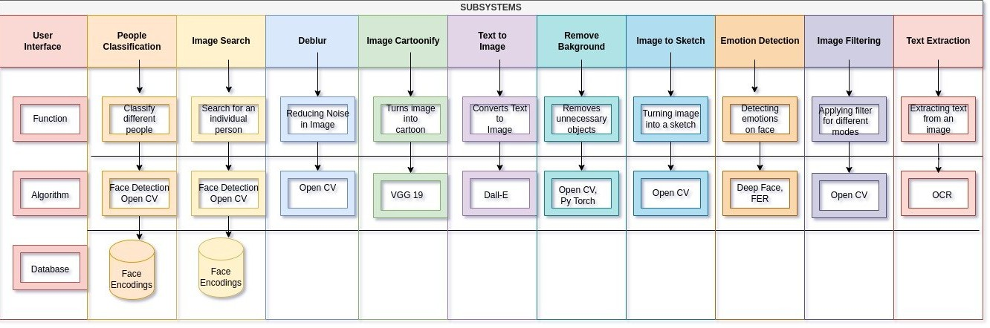
Architecture

Slide 7

Technology
The list of technology is mentioned below:
Flask Python Node.js Firebase
Machine Learning

Slide 8
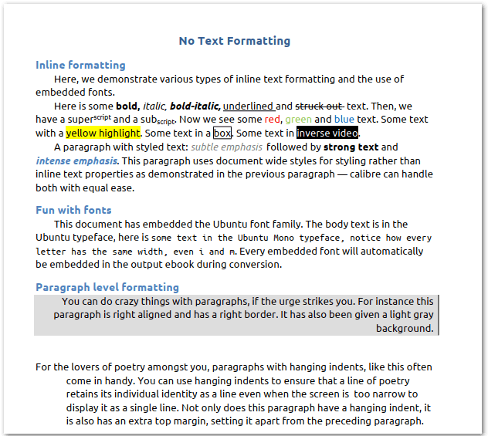
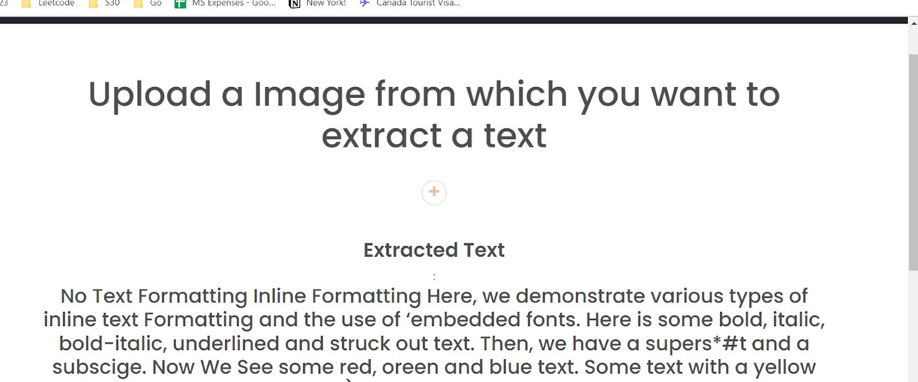
Features
1) Optical Character Recognition: OCR/ Optical Character Recognition is an algorithm that actually extracts text from an image that is useful for image ﬁltering to categorize in different albums. Pytesseract is a Python wrapper for the Tesseract OCR engine.

Slide 9
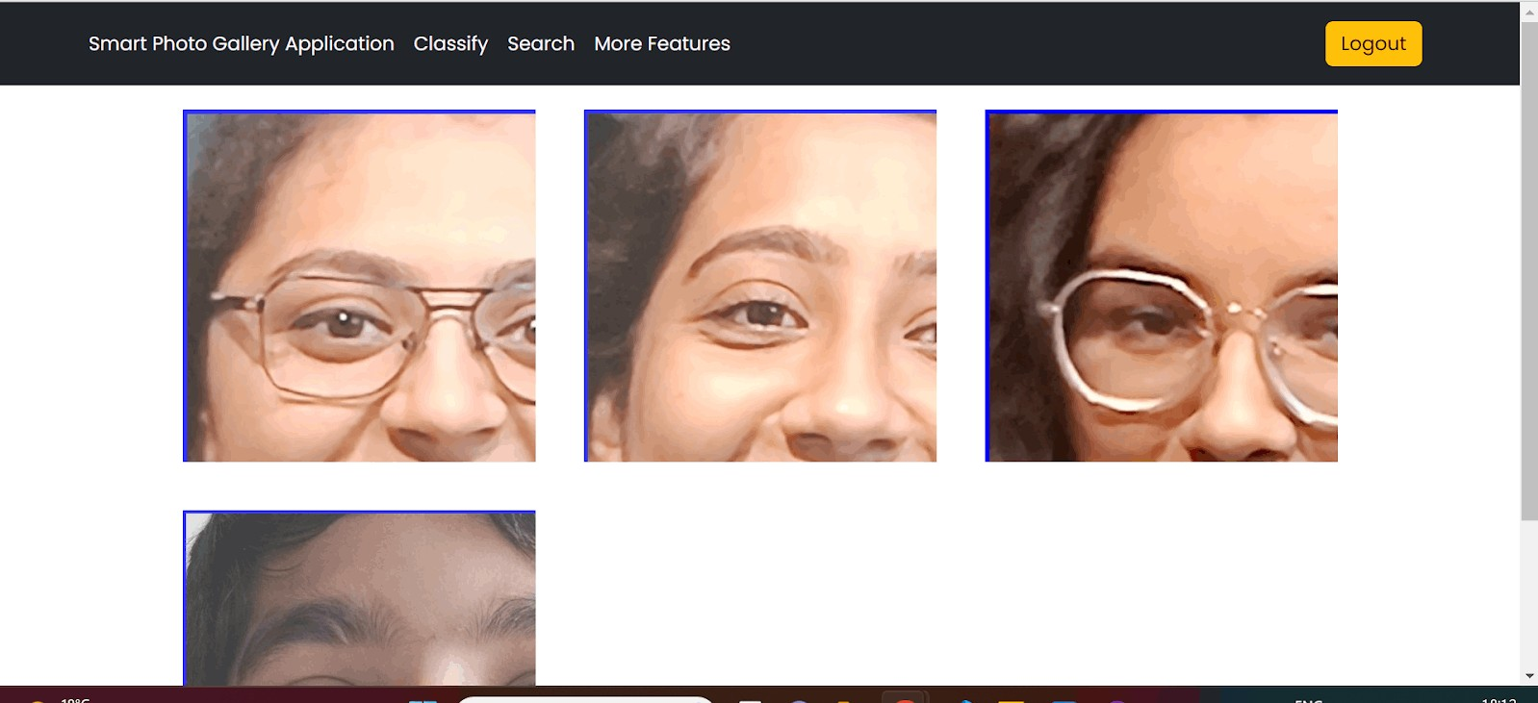
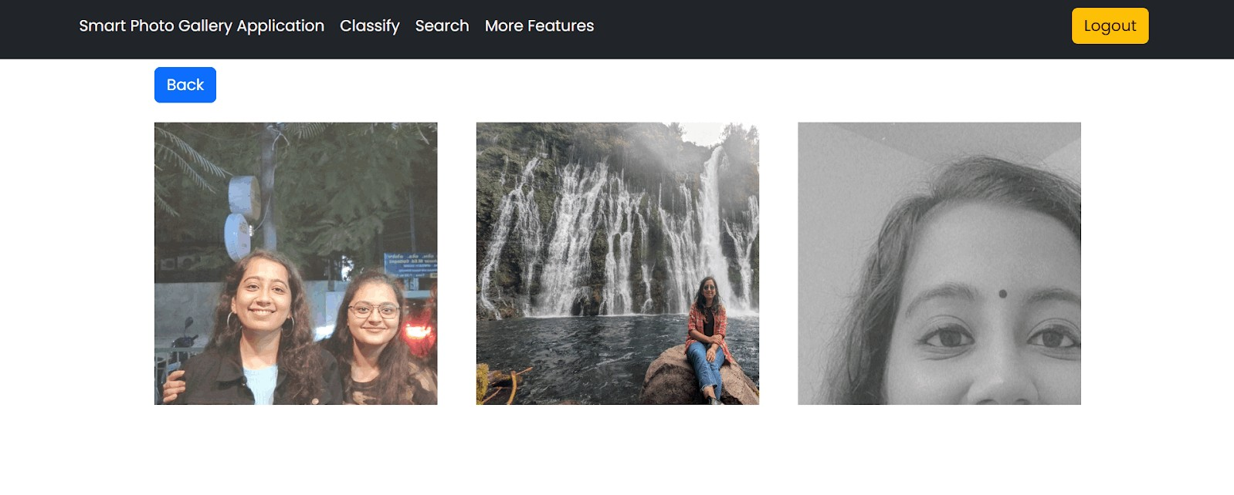
Features
2) Face Recognition: Two face detection and face
recognition patterns make up a whole face recognition system. There are both general structural similarities and speciﬁc local variances in the biological features of the face. In order to remove the faces from the background pattern and perform face recognition on the separated faces, it is required to extract the structural features of the face using the face detection method. To separate the identity of the face from the image, this procedure involves extracting normalized face images, followed by contrast and identiﬁcation.
The examples on side shows classiﬁcation and searching of image using face recognition.

Slide 10
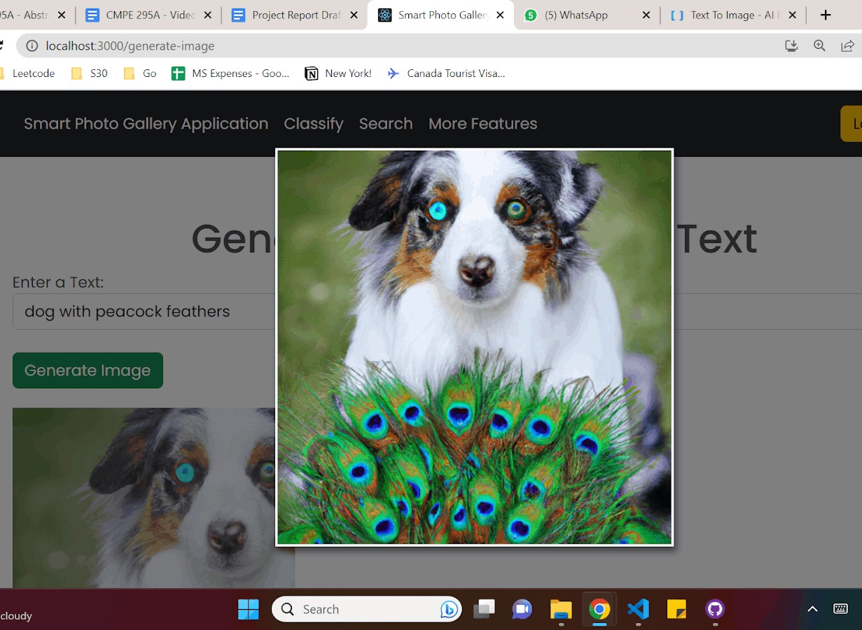
Features
3) Text to Image Generation: Conversion of process from text typed to the image by using Dall-E. Dall-E is the most advanced
neural network. It is a 12-billion parameter
version of text language processing GPT-3 which was trained to generate images from text descriptions. In the core it has a diverse set of libraries that we can create even anthropomorphized versions of animals and objects as well. The OpenAI DALL-E model is a neural network that generates images
from textual input.

Slide 11
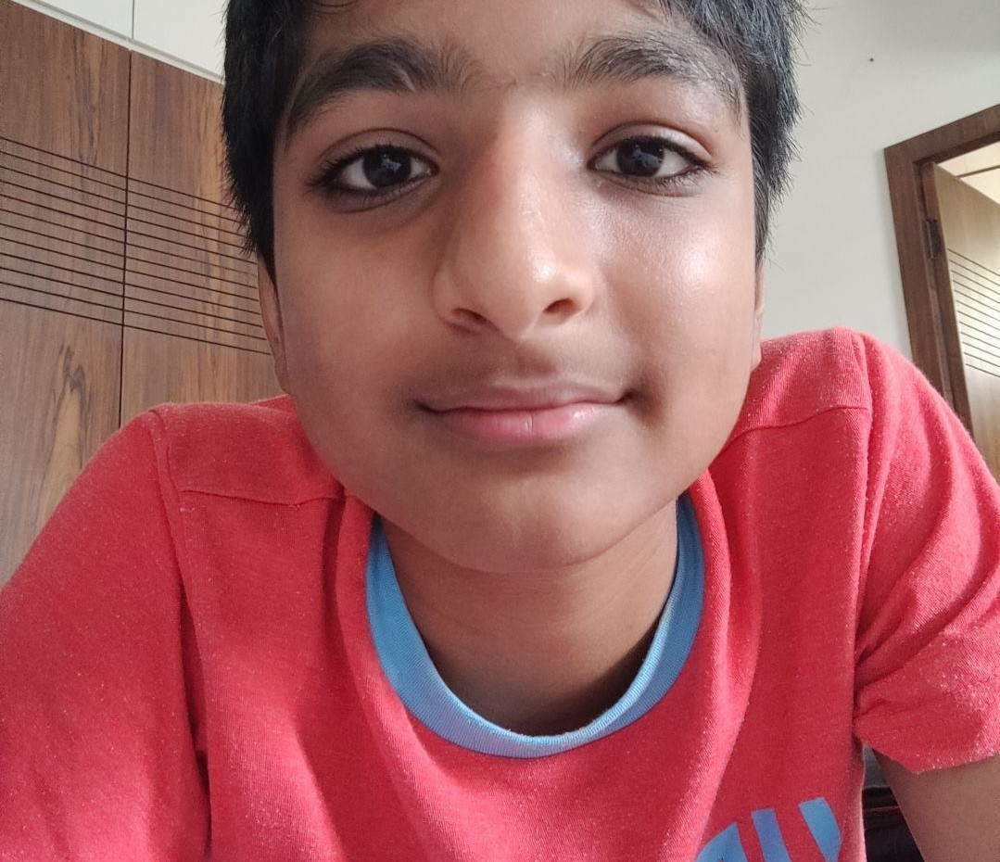
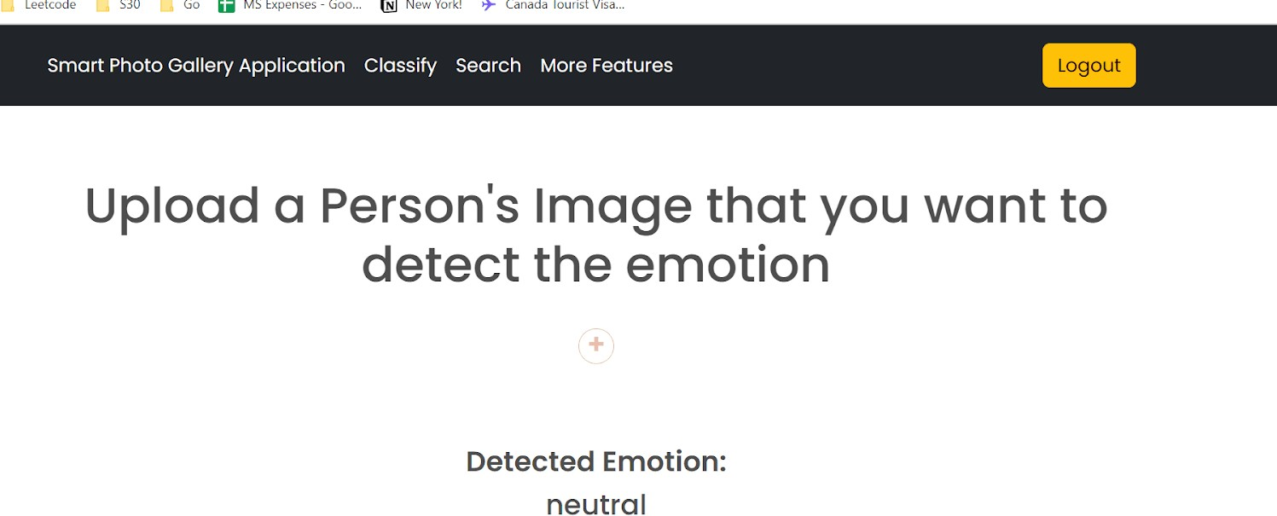
Features
4) Emotion Detection: Detecting sentiments and emotions on a person's face using Deep face to analyze the aspects like age, gender, race and
emotions and separating those emotions from the image to make it more accurate using FER (Facial Emotion Recognition).

Slide 12
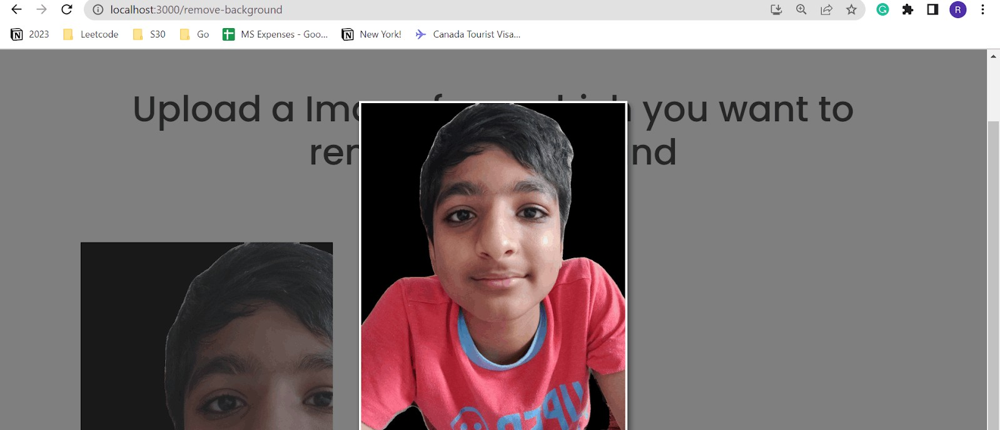
Features
5) Remove Background: Removing background of the image by differentiating the foreground that it might be a person and the background by using
opencv recognition and with the help of pytorch we can completely separate and remove the background.

Slide 13
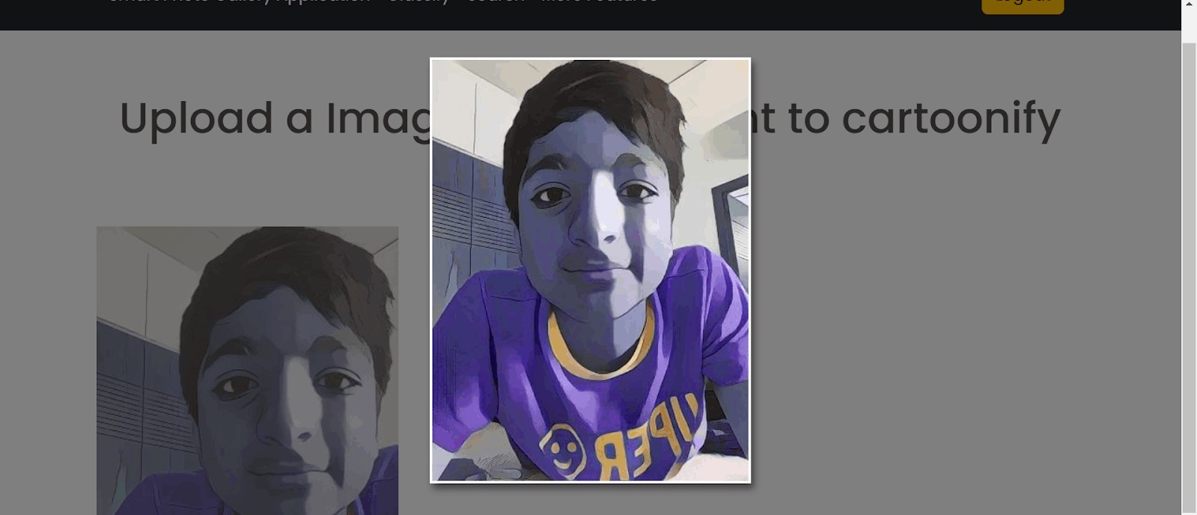
Features
6) Image Cartoonify: Converting the images into cartoons using transformers most state of the art model VGG 19, one of the most powerful deep
learning algorithms that uses 19 layers of prediction levels. It has an extraction feature from statistical convolution neural networks.

Slide 14
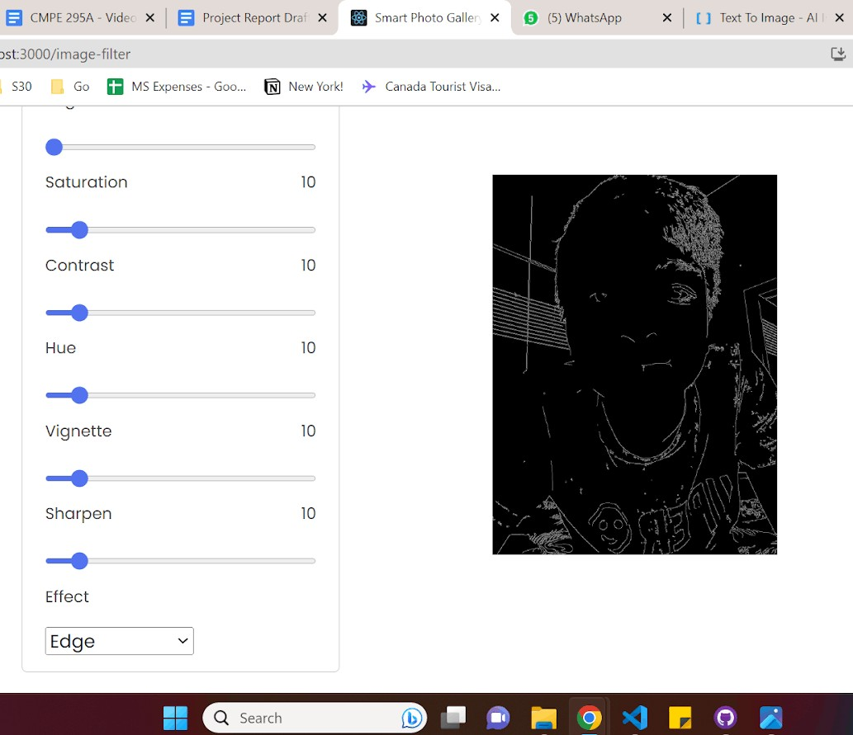
Features
7) Image Filter: Tuning images by using different
ﬁlters like warm, cool and monochrome and to have a more likable image is done by using OpenCV.
In the core it does is gray scaling complete image and adding a preset ﬁlter to it which includes all the Hue, Saturation techniques.
The Gaussian ﬁlter is a linear smoothing ﬁlter that is based on the Gaussian probability distribution
function.

Slide 15
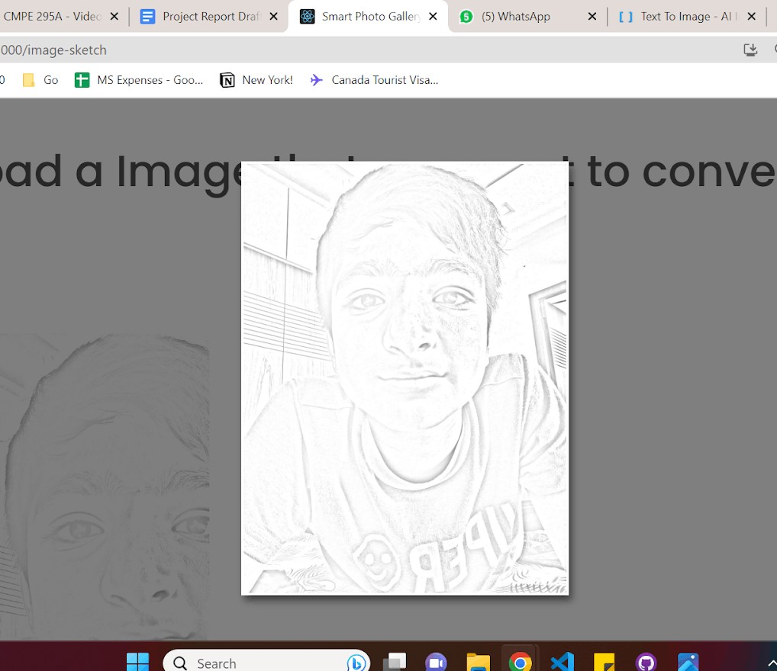
Features
8) Image to Sketch: Turning the image into an art.
Artifying the input image using OpenCV where it
detects the image and changes it to grayscale to turn into a sketch by eliminating high frequency spectrum from the image.

Slide 16
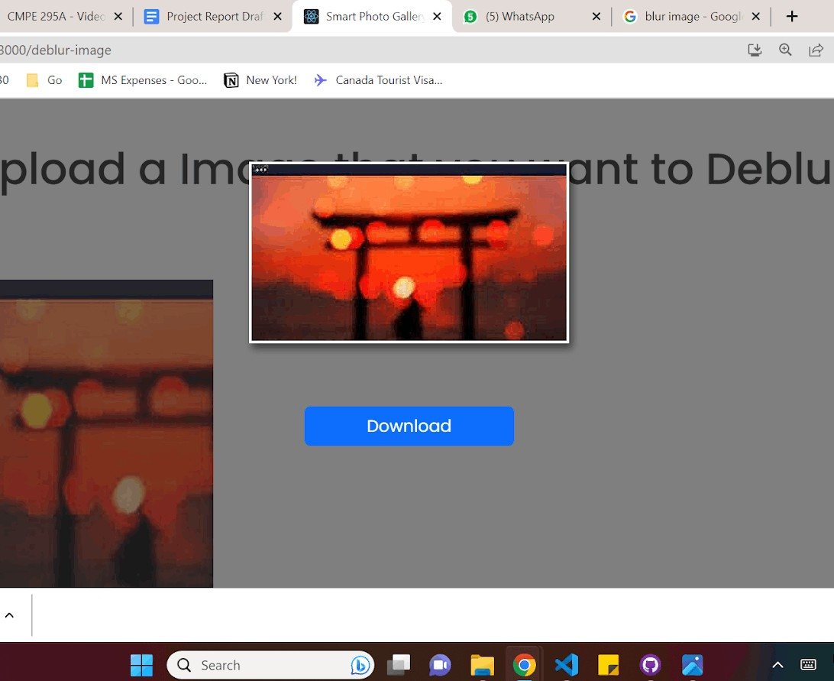

Features
9) Image Deblur: The basic idea of sharpening is
to enhance the edges and details within an image to make it appear clearer and more deﬁned. Using Opencv we can unblur the image. The objective is
to restore the original image. In the core it
functions the degradation image model where it achieves the original spectrum by removing additive noise, frequency of the spectrum and
frequency response.

Slide 17
Conclusion
Albeit of having many challenges in creating this application on a promised standard, we strove hard to keep up those words to deliver the application by referring various articles and improving our research skills.
This improvement towards real-world applications and much more improvement in every stage and throughout the process and it was a great learning experience.
Here are few of our observations to conclude with:
The overall outcome of this application combines current state of the art algorithms with most eﬃcient and unique approaches.
But in fairness, even though one of the top most applications such as google photos has features that are not so limited but less in comparison has a very great way of integration and implementation.
As the new emerging technologies are coming into the market daily, the current state-of-the-art methods are becoming outdated and new technologies might be more appropriate instead of the current technologies used, so all of the features can be updated with new technologies for image enhancement and boost customer satisfaction.

Slide 18
Thank You!

